Slide 1
Milwaukee’s Theater Scene: The Evolution Of The Milwaukee Repertory Theater
Terese Radke

Slide 2
Table of contents
Theater in 1950s Milwaukee
History of the Milwaukee Repertory Theater
Mary John
Drama Inc.
Fred C. Miller
The Fred Miller Theatre
Types of Productions
The Milwaukee Repertory’s Locations
The Milwaukee Repertory’s First Season (1954-1955)
First Season Photos
The Milwaukee Repertory’s First Season (1954-1955) Report
The Milwaukee Repertory’s 65th Season (2018-2019)
65th Season Photos
The Milwaukee Repertory’s 65th Season (2018-2019) Report
First and 65th Seasons Comparison
RESOURCES
The Importance of Community Representation in Milwaukee’s Theaters
Accessible Theater Opportunities
Black Arts MKE
Bronzeville Arts Ensemble
Milwaukee Public Theatre
Why Accessible Theater Matters
References

Slide 3
Theater in 1950s Milwaukee
In the 1950s, there were theaters that produced plays before the Milwaukee Reparatory Theater was founded, like the Davidson, the Pabst, the Alhambra.
Milwaukee was a theater-going town, shown from attendance of plays at these venues. Yet, none of these venues were dedicated fully to theater plays/musicals.
With an increase in movie going, the amount of Broadway tours declined.
The decline of touring shows deprived Milwaukee of good productions. A residential professional theater company would allow for quality experiences.
(Mission Statement/Business Plan, 3)

Slide 4
History of the Milwaukee Repertory Theater
The Fred Miller Theatre (now the Milwaukee Repertory Theater) was created to provide year-round access to theater for Milwaukee residents.
The addition of a theater in Milwaukee would be important to the Milwaukee residents’ cultural life.
Since Milwaukee had an entertainment scene, from beer to baseball, it held promise for theater.
(Press Release from Fred Miller Theatre re “A town well known for…”)

Slide 5
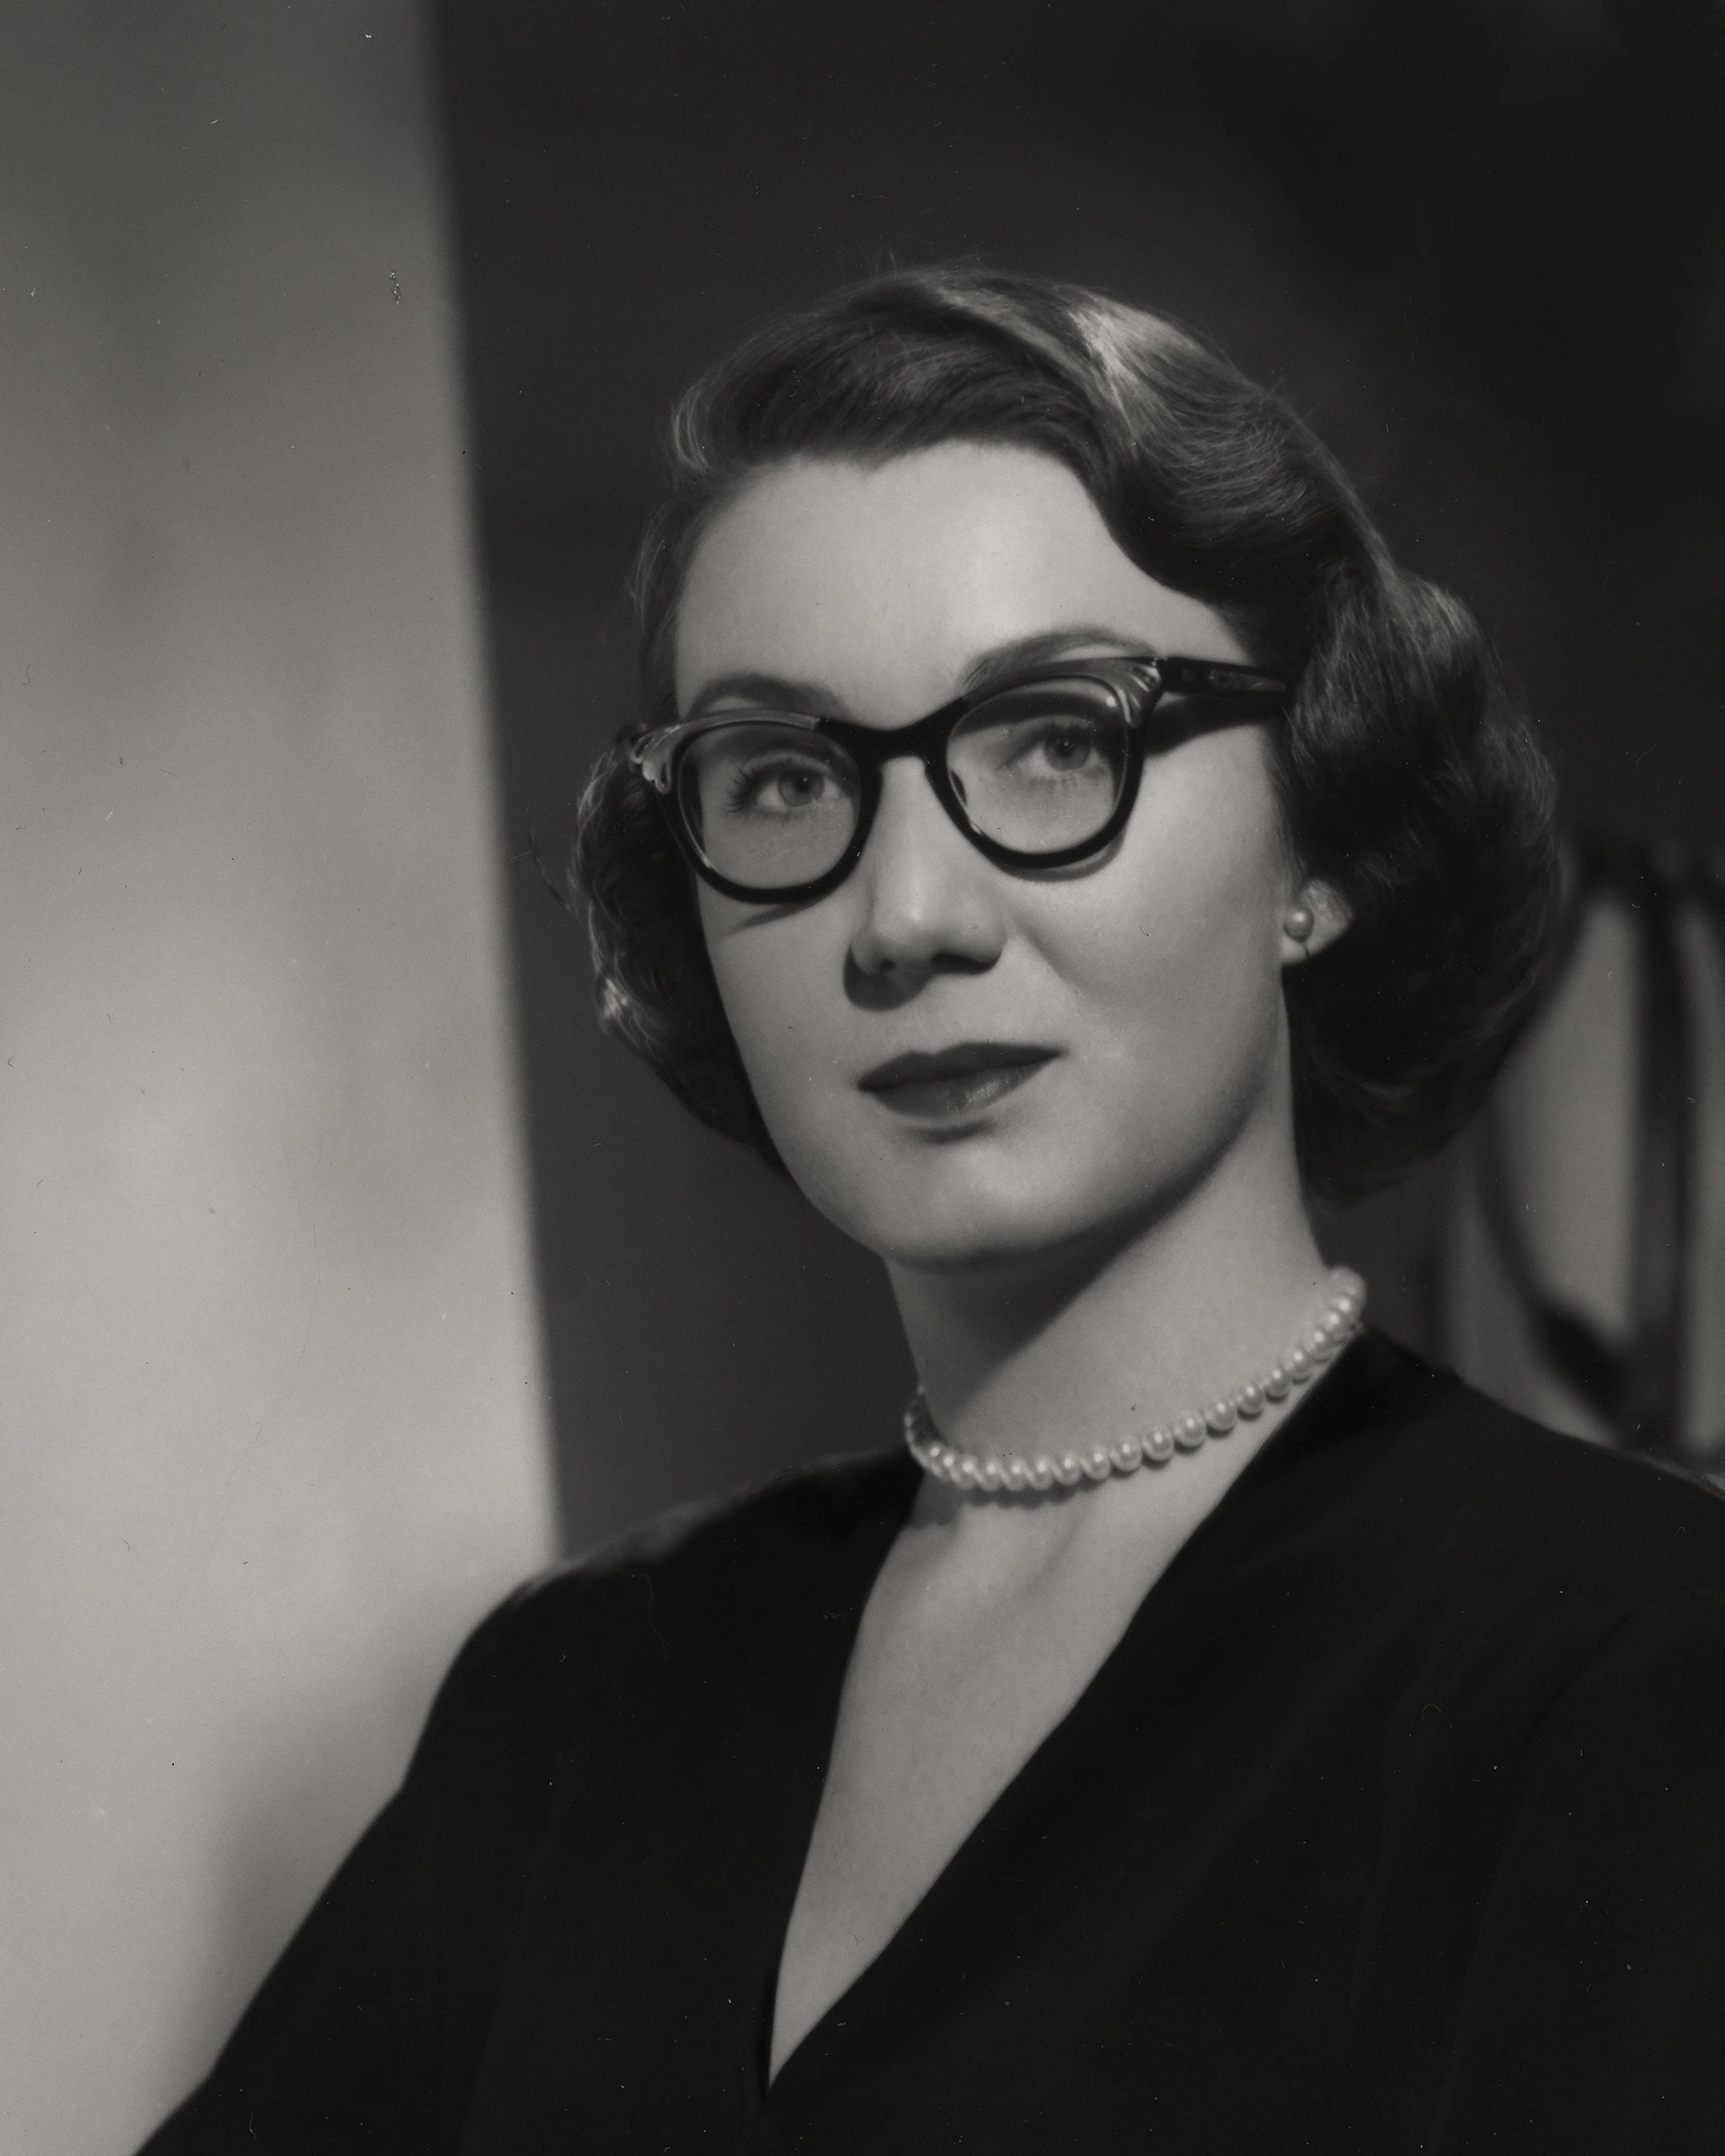
Mary John
Mary Widrig John, a Milwaukee resident, desired to create a professional theater for Milwaukee.
John was the president of Drama Inc. and managing director of the Fred Miller Theatre.
John majored in Drama at Northwestern University and mastered in Stage Production at the University of Wisconsin (Conlin).
She created Drama Inc., a non- profit theater production company, which brought the opportunity of professional theater to Milwaukee and build the Fred Miller Theatre (“Milwaukee Repertory Theatre Records, 1953-1987.”).
Photo by marywjohn.com

Slide 6
Drama Inc.
The creation of Drama Inc. “will be an important step forward in Milwaukee’s civic and cultural growth” (Mission Statement/Business Plan, 1).
Their goal was “to present a season of good plays each year, and to have [the audience] enjoy them as much as we enjoy presenting them” (Mission Statement/Business Plan, 3).
Drama Inc. would include a drama and fine arts school tied to the Fred Miller Theatre.
The Drama, Incorporated School of the Professional Arts trained students in theater works from 1955 to 1959 (“Milwaukee Repertory Theatre Records, 1953-1987.”) .

Slide 7
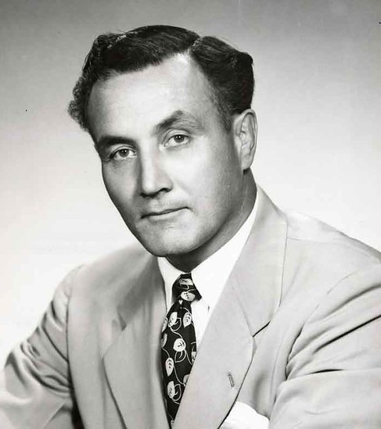
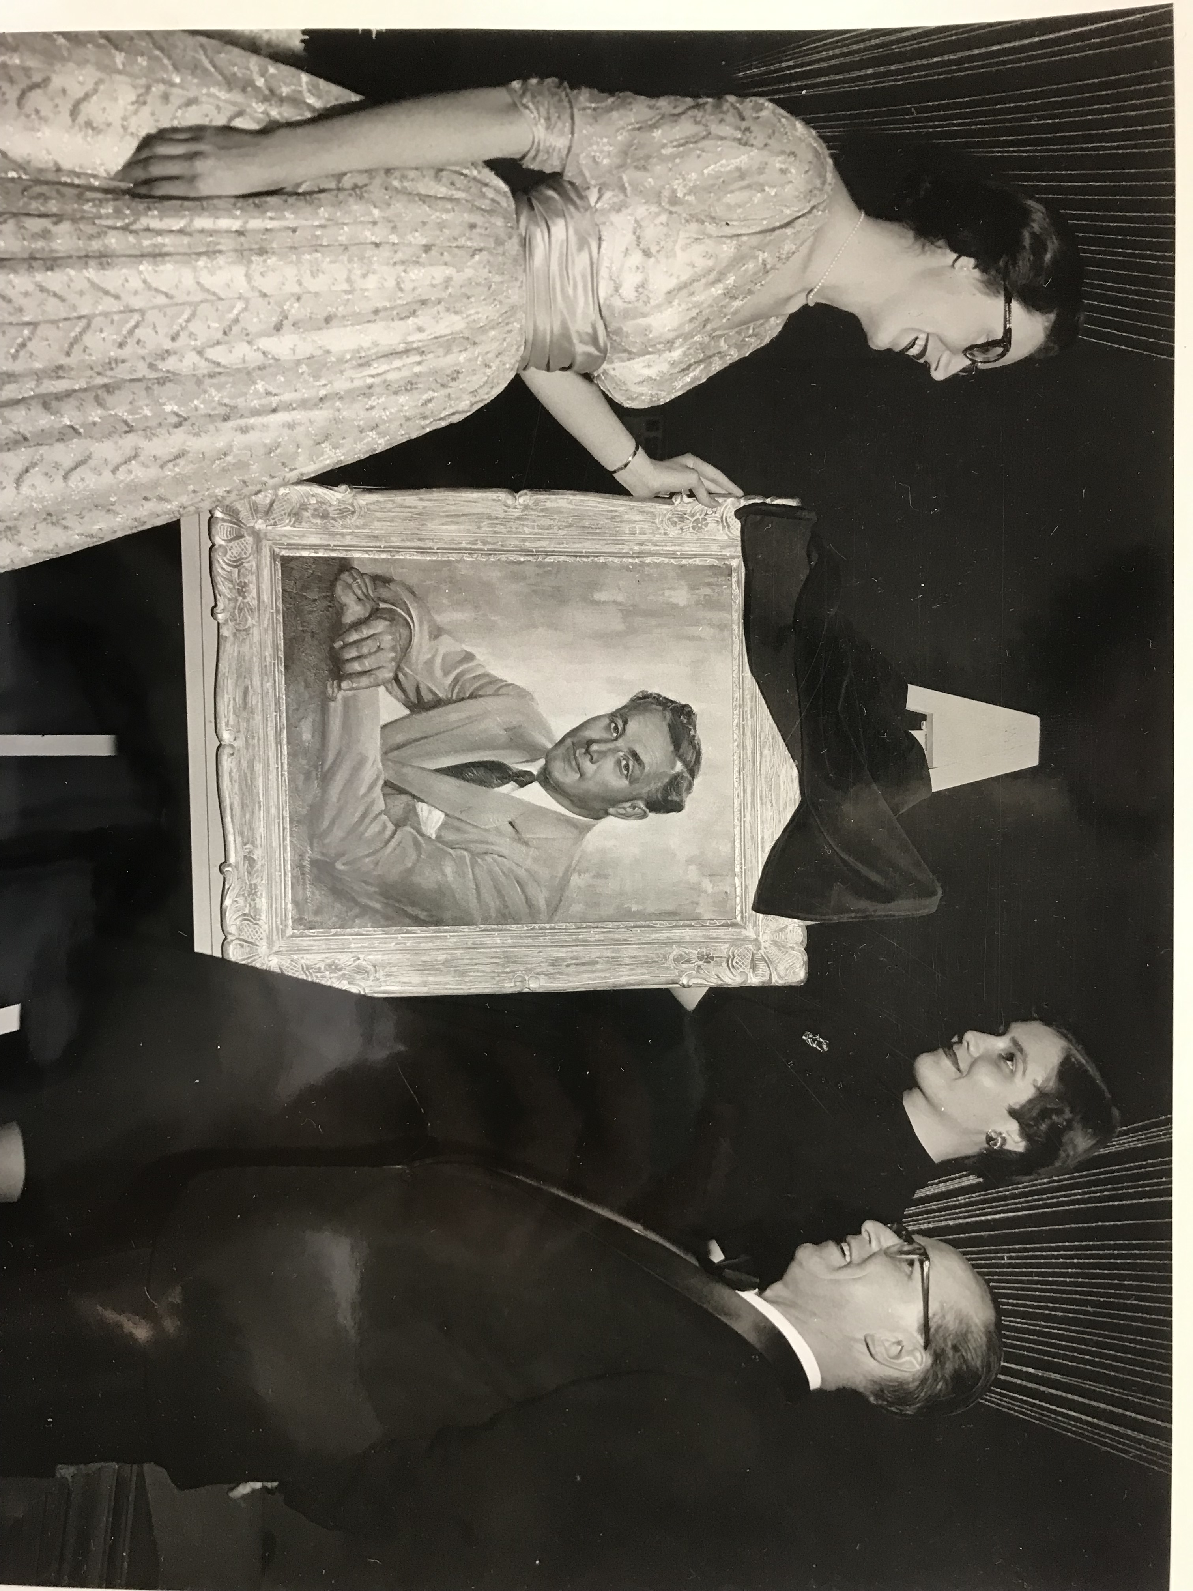
Fred C. Miller
Photo by Brookston Beer Bulletin
The original name of the theater was the Milwaukee City Circle. Up until December 1954, press releases and newspaper articles referred to the project by that name or just City Circle.
Fred C. Miller, the head of the theater fundraising team and the president of the Miller Brewing Co., died in a plane crash on December 17, 1954.
The Drama Inc. Board decided to name the theater the Fredrick C. Miller Memorial Theatre, in his honor.
Photo by The Milwaukee Repertory Theater
Box 6 Folder 8
(“A Miller Memorial”)

Slide 8
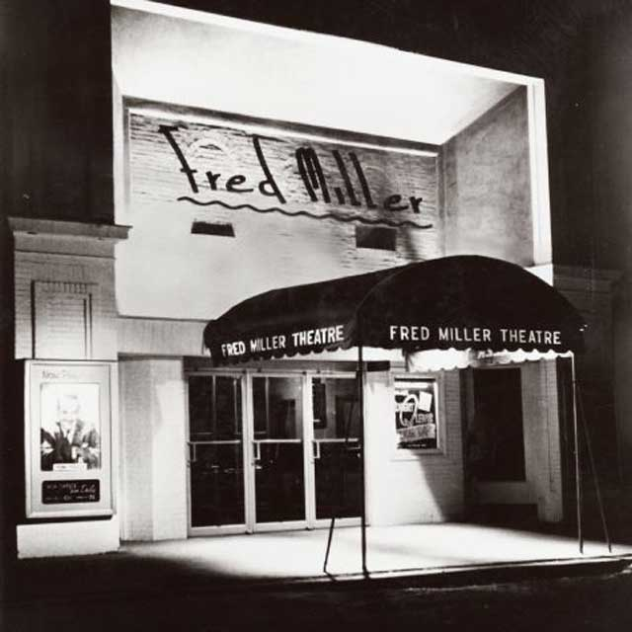
The Fred Miller Theatre
The Fred Miller Theatre opened on January 25th,1955.
Mayor Frank Ziedler declared January 25, 1955 “Drama Day” in Milwaukee as a show of support to the theater’s creation and its benefits to the Milwaukee community (Draft of Letter to Mayor).
Milwaukee residents contributed $116,656.19 to fund the nonprofit’s start (Press Release from Fred Miller Theatre re “Milwaukee’s new professional theatre…”).
At the time, this theater was the only professional winter arena theatre in Wisconsin and one of eleven in the United States (Press Release from Fred Miller Theatre re “Milwaukee’s new professional theatre…”).
Photo by The Milwaukee Repertory Theater

Slide 9
Types of Productions
The first few seasons were the Broadway straight plays featuring out-of-town star performers to attract audiences.
A straight play is a theater production with no singing (“Idiom: A Straight Play”).
In the 1960s, the productions changed into classics and premieres of new works while relying on a resident professional company of actors from the surrounding areas to cast in productions (Mission Statement/Business Plan, 1).
In 1963, the theater was renamed the Milwaukee Repertory Theater, which remains to the present day (“Our History.”).

Slide 10
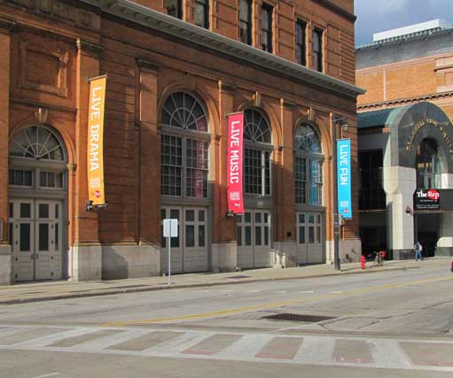
The Milwaukee Repertory’s Locations
First, the theater was a converted from the Oakland Theatre, a movie house. It was located at 2842 North Oakland Avenue in Milwaukee.
The Fred Miller Theatre originally held 338 seats.
Currently located in a converted power generation plants known as the Patty and Jay Baker Theater Complex.
It houses the Milwaukee Repertory Theater’s three performance spaces
The Quadracci Powerhouse (720 Seats)
The Stiemke Studio (205 Seats)
The Stackner Cabaret (186 Seats).
Also retains the Pabst Theater for the annual production of A Christmas Carol for the past 43 years.
Photo by The Milwaukee Repertory Theater
(“Our History.”)

Slide 11
The Milwaukee Repertory’s First Season (1954-1955)
Sabrina Fair by Samuel Taylor
Cyprienne by Dorothy Monet
Kind Lady by Edward Chodorov
Affairs Of State by Louis Verneuil
Shadow And Substance by Paul Vincent Carroll
Late Love by Rosemary Casey
The White Sheep Of The Family by L. Dugarde Peach and Ian Harry
The Philadelphia Story by Philip Barry
Angel Street by Patrick Hamilton
FANFARE: A Variety Show
Oh, Men! Oh, Women! by Edward Chodorov
The Fred Miller Theatre produced 10 straight plays and one variety show in its first season varying from romance to comedy to drama
(“Production History 1954-1980.”)

Slide 12
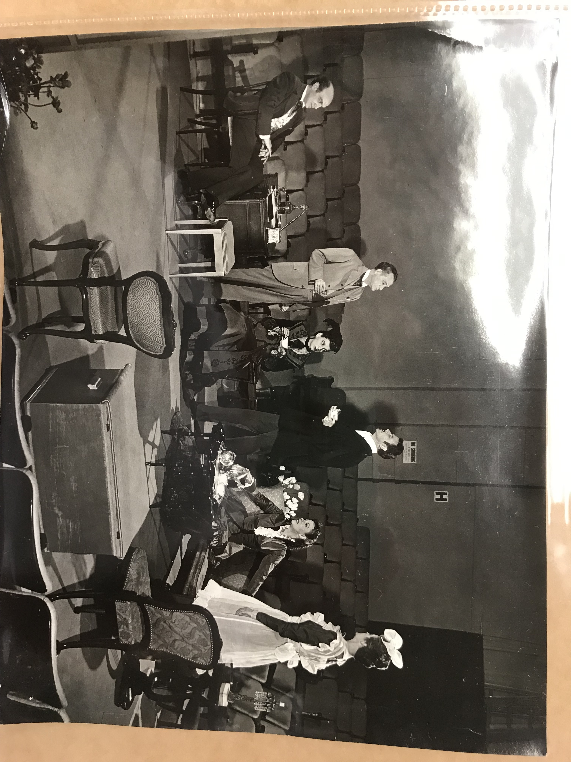
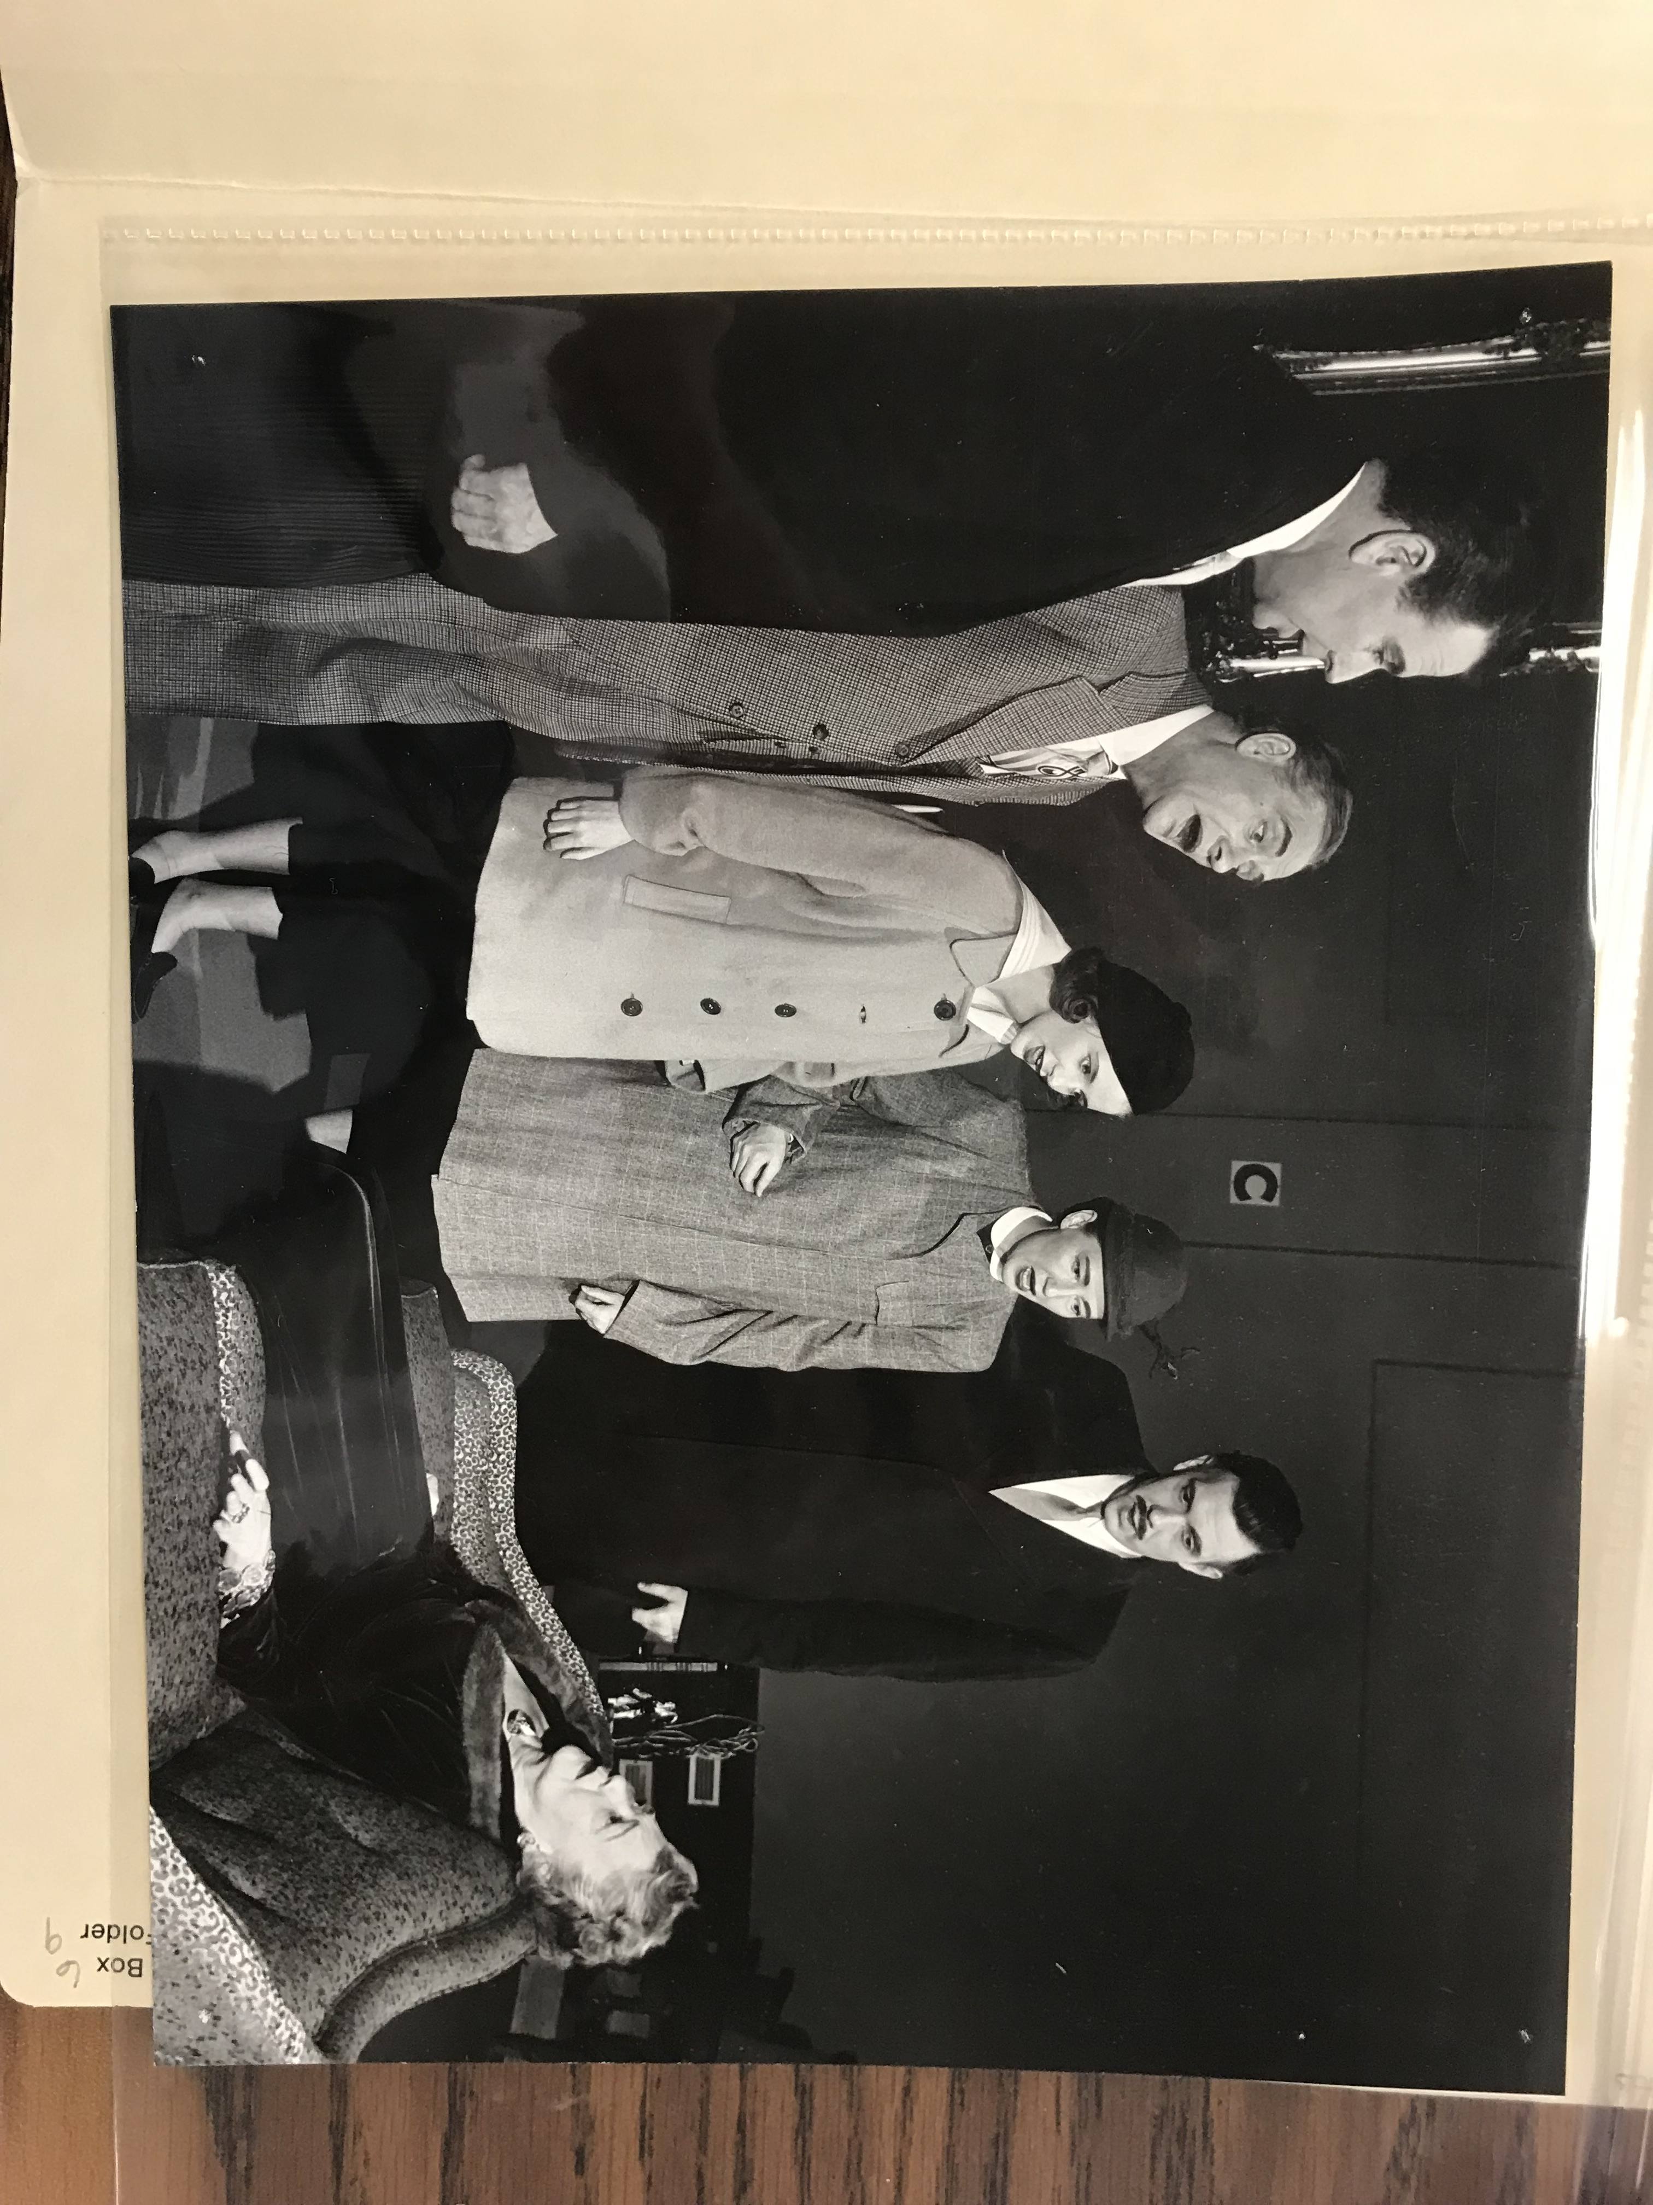
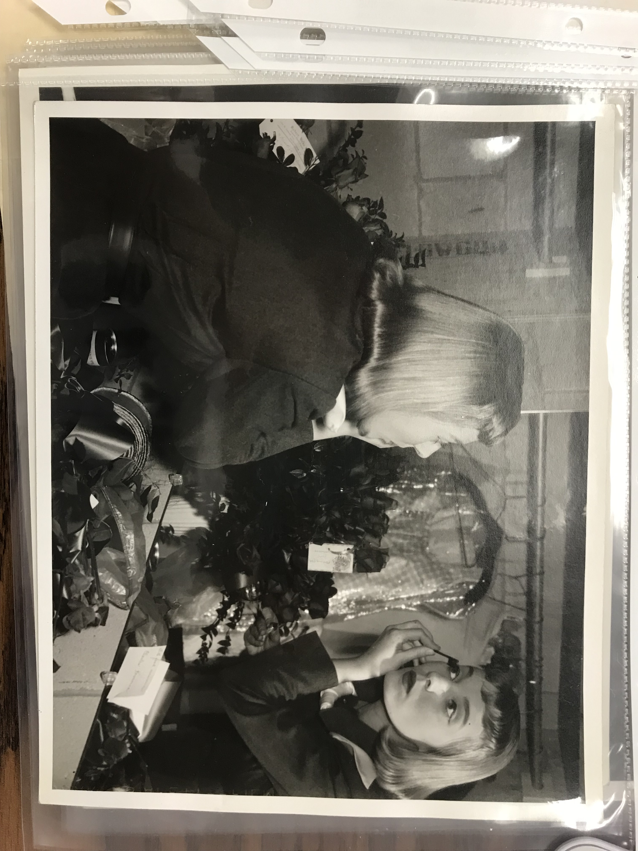
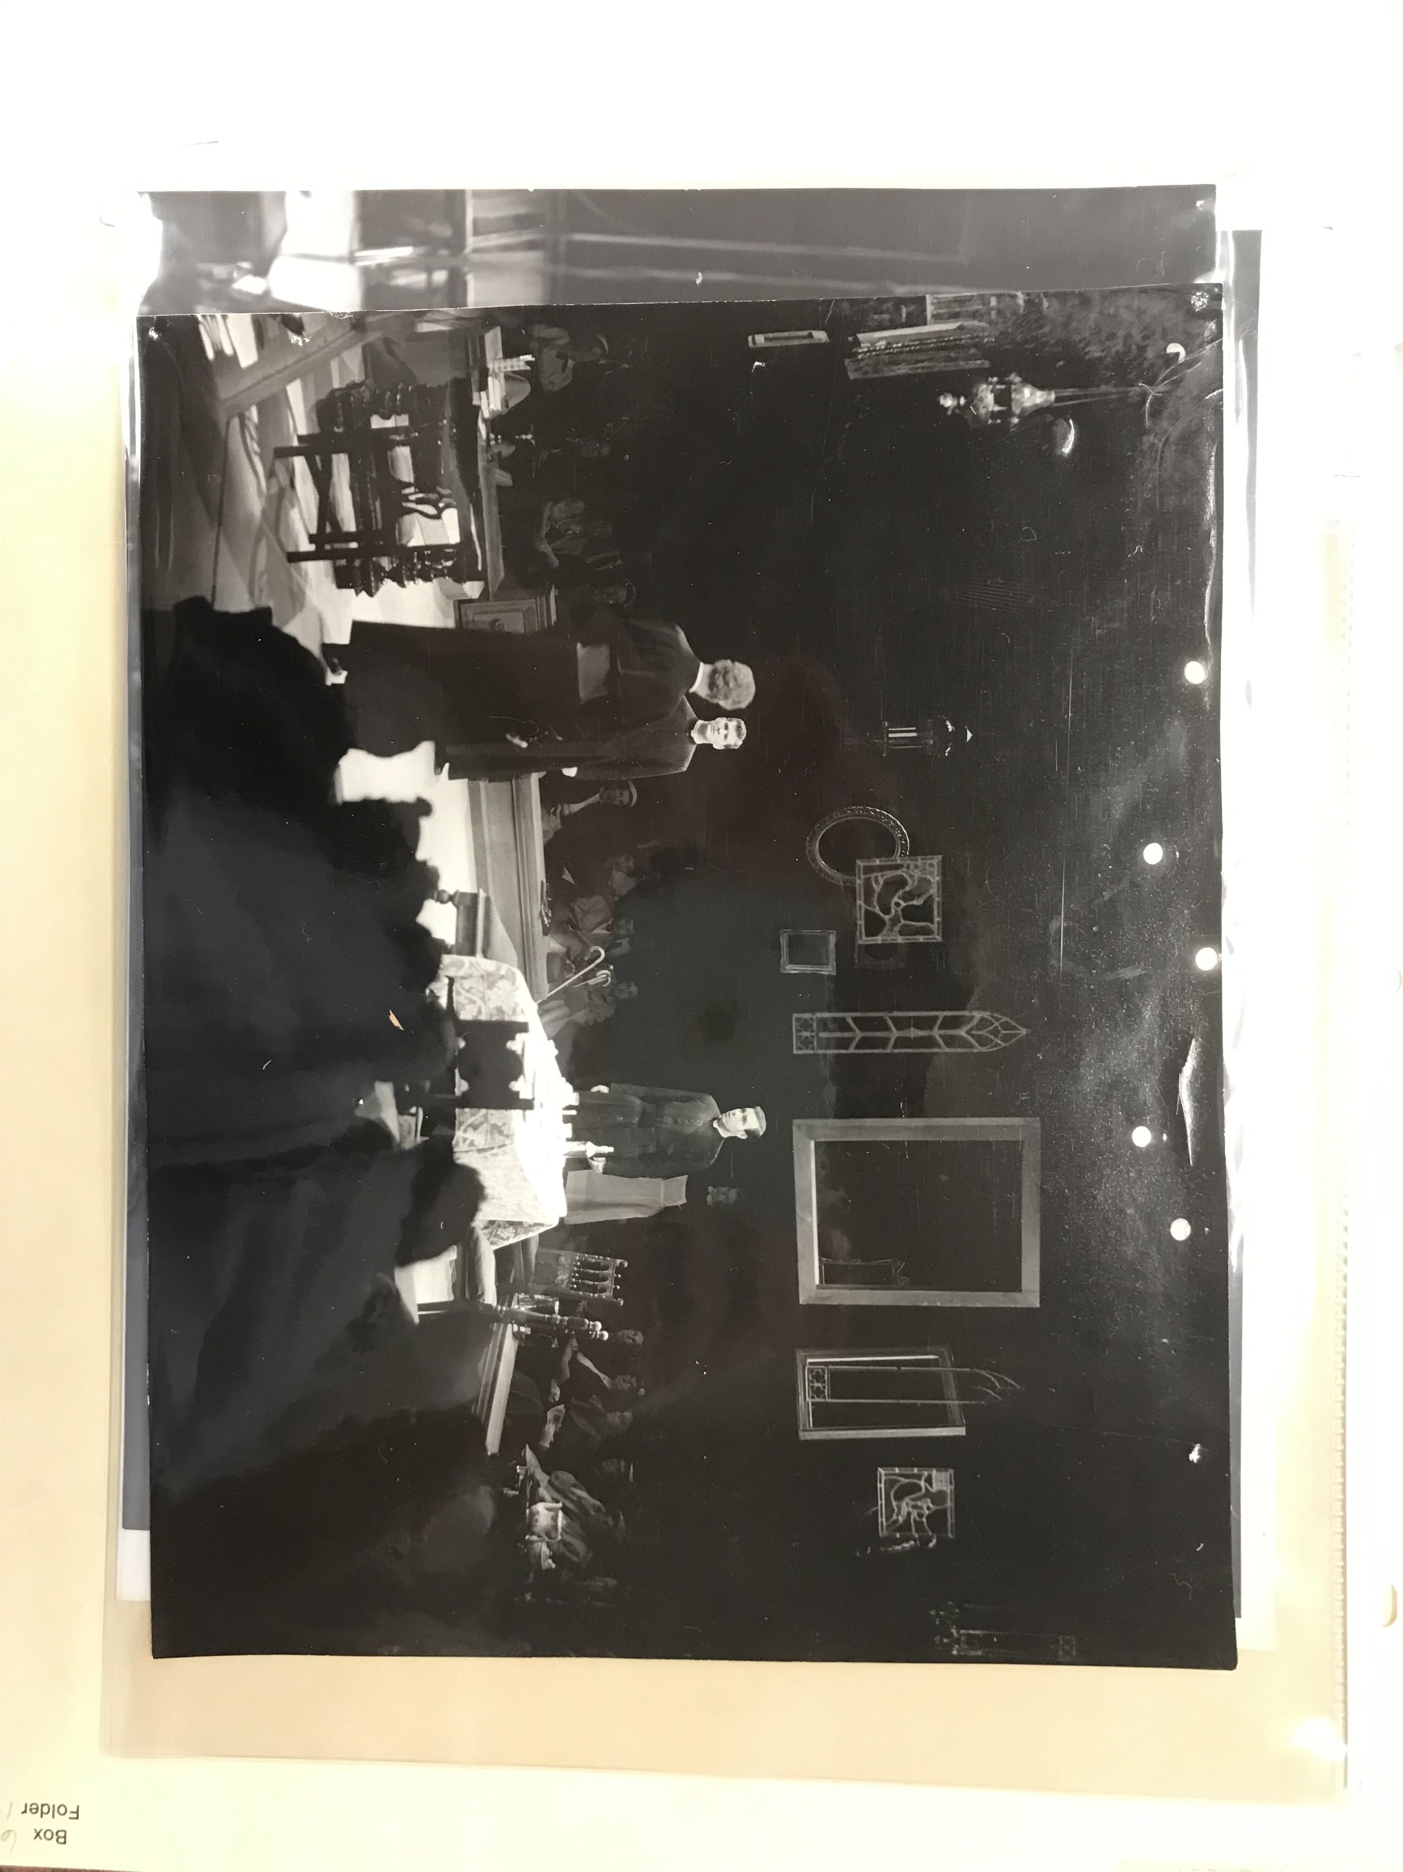
Cyprienne Box 6 Folder 7
Kind Lady Box 6 Folder 9
Late Love Box 6 Folder 12
Philadelphia Story Box 6 Folder 13
Shadow and Substance Box 6 Folder 10
Sabrina Fair Box 6 Folder 8
White Sheep of the Family Box 6 Folder 11
Oh Men! Oh Women! Box 6 Folder 14
Photos by The Milwaukee Repertory Theater Box 6 Folder 7-14
11

Slide 13
The Milwaukee Repertory’s First Season (1954-1955) Report
At the time, the audiences came from all around Milwaukee:
60% from the north east side & northern suburbs
10% from the west side
20% from the south
10% from out of town (Press Release from Fred Miller Theatre re “A town well known for…”)
The first season was a success, with box office receipts being enough to cover operation of the theater.
Milwaukee residents came in regular attendance as well (John).
25,780 audience members over 80 performances of 5 plays. That’s a 94% attendance rate (Brower).

Slide 14
The Milwaukee Repertory’s 65th Season (2018-2019)
Stiemke Studio
Guards At The Taj by Rajiv Joseph
The Chinese Lady by Lloyd Suh
Every Brilliant Thing by Duncan Macmillan With Jonny Donahoe
Lost Girl by Kimberly Belflower
Rep Lab A Short-play Festival Featuring The Rep’s Emerging Professional Residents
Stackner Cabaret
Songs For Nobodies by Joanna Murray-smith
The All Night Strut! By Fran Charnas
Mark Twain’s River Of Song by Randal Myler and Dan Wheetman
Ring Of Fire: The Music Of Johnny Cash by Richard Maltby, Jr.
PABST THEATER
A Christmas Carol Adapted By Mark Clements
Quadracci Powerhouse
In The Heights by Lin-Manuel Miranda
Miss Bennet: Christmas At Pemberley by Lauren Gunderson and Margot Melcon
Junk by Ayad Akhtar
Things I Know To Be True by Andrew Bovel
Two Trains Running by August Wilson
(“2018/2019 Season.”)

Slide 15
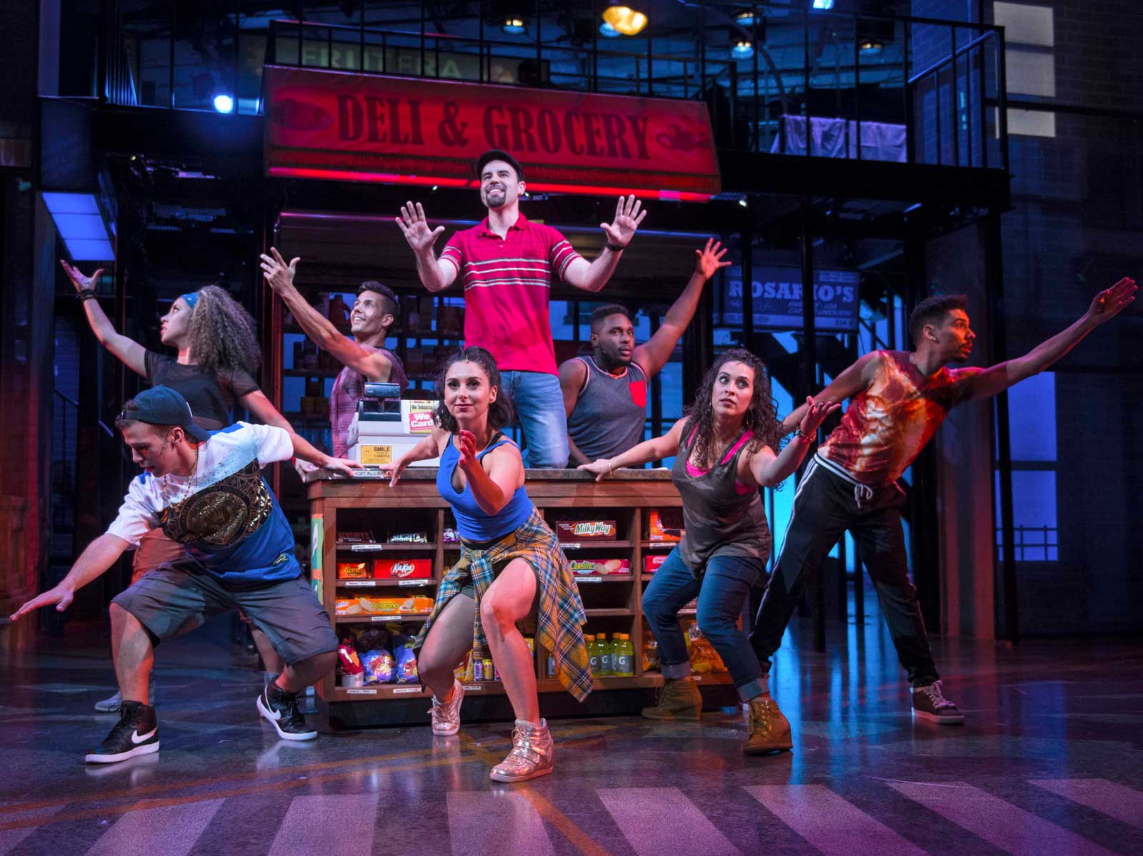
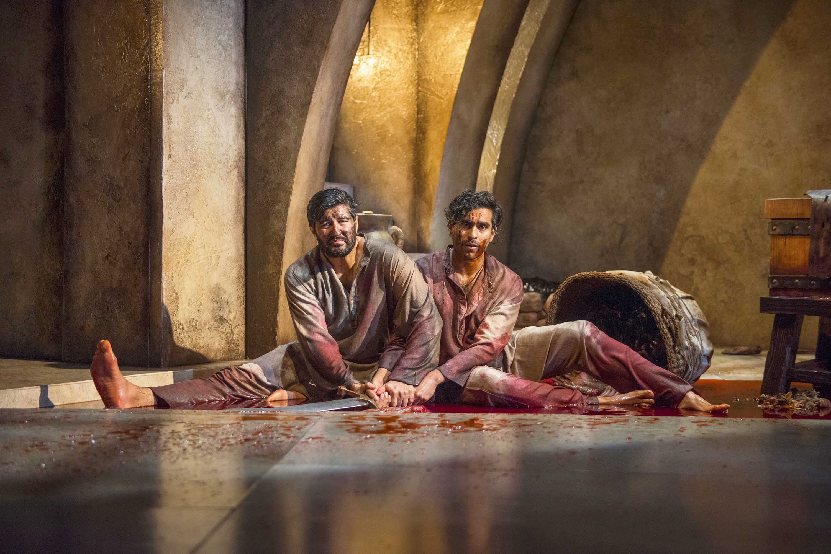
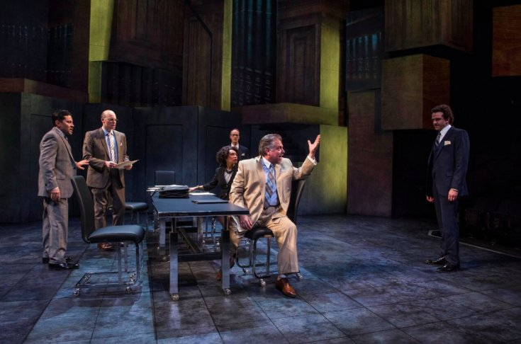
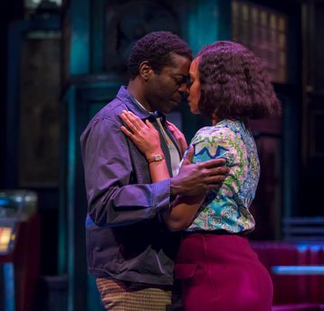
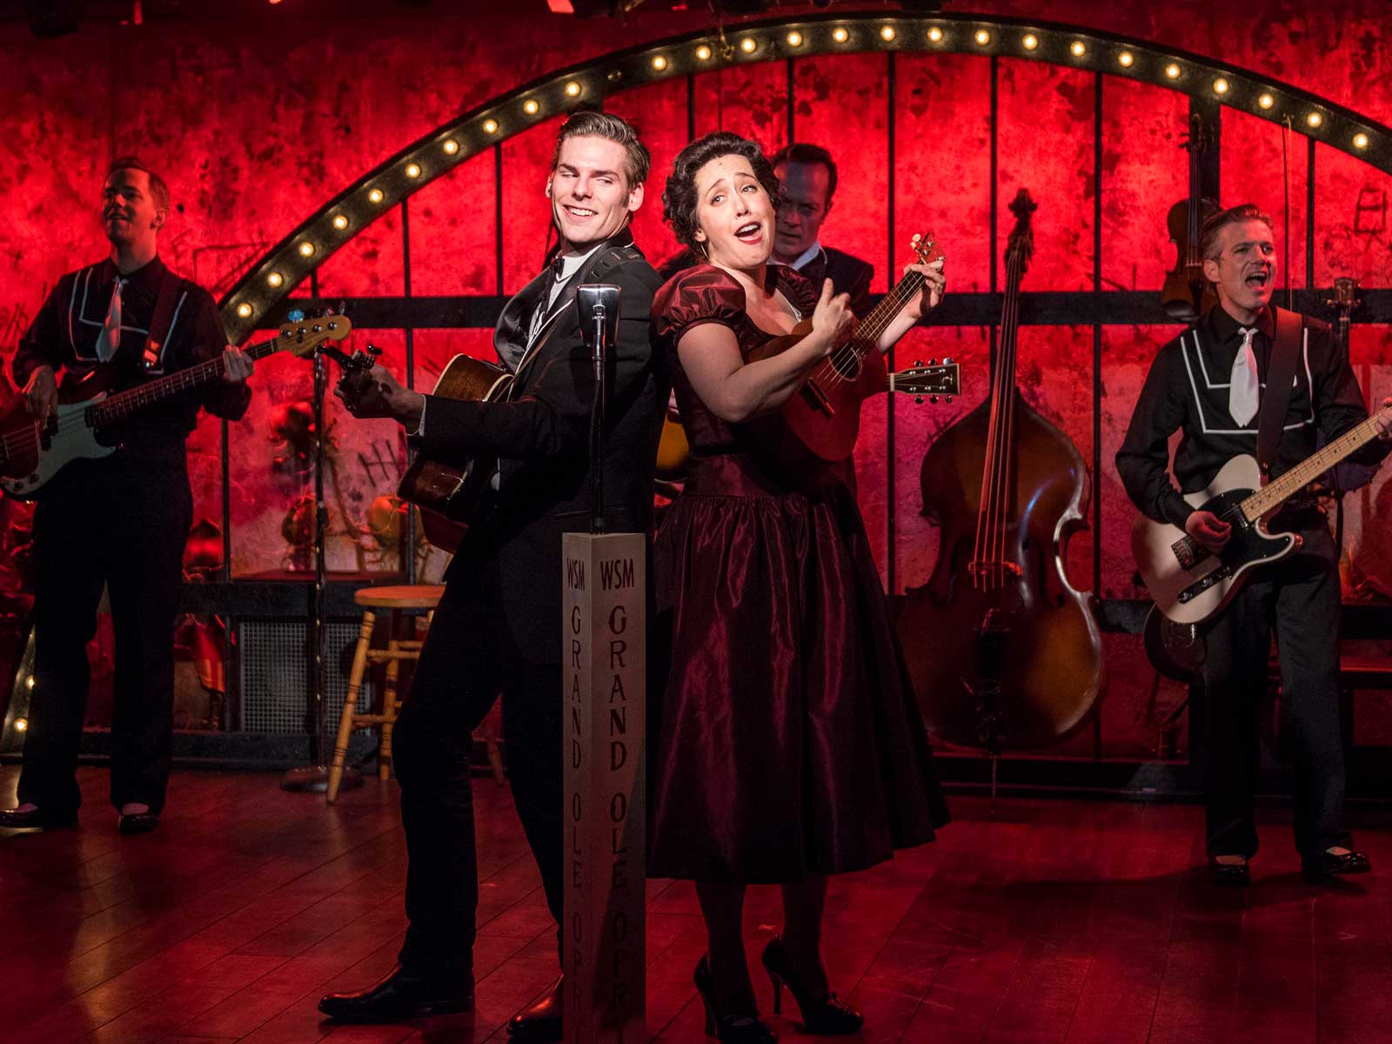
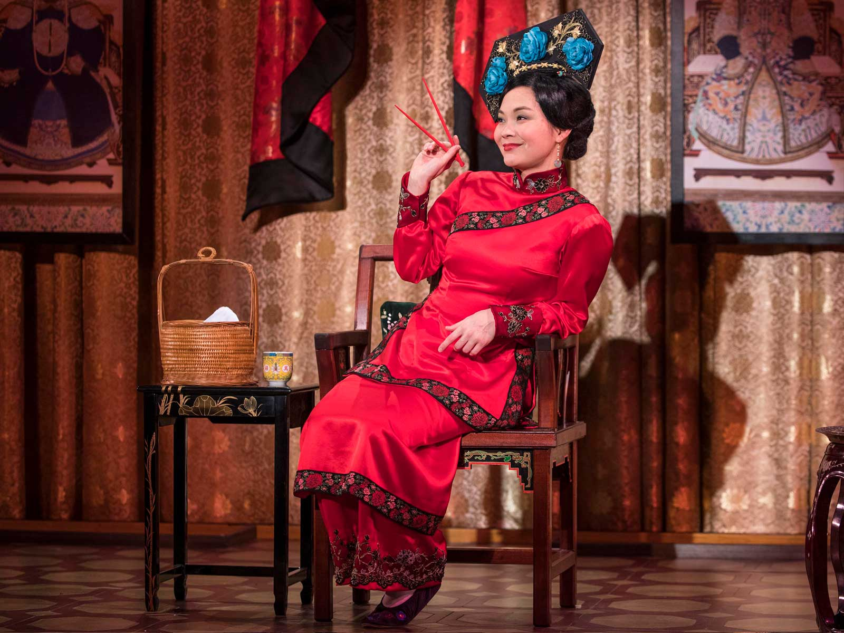
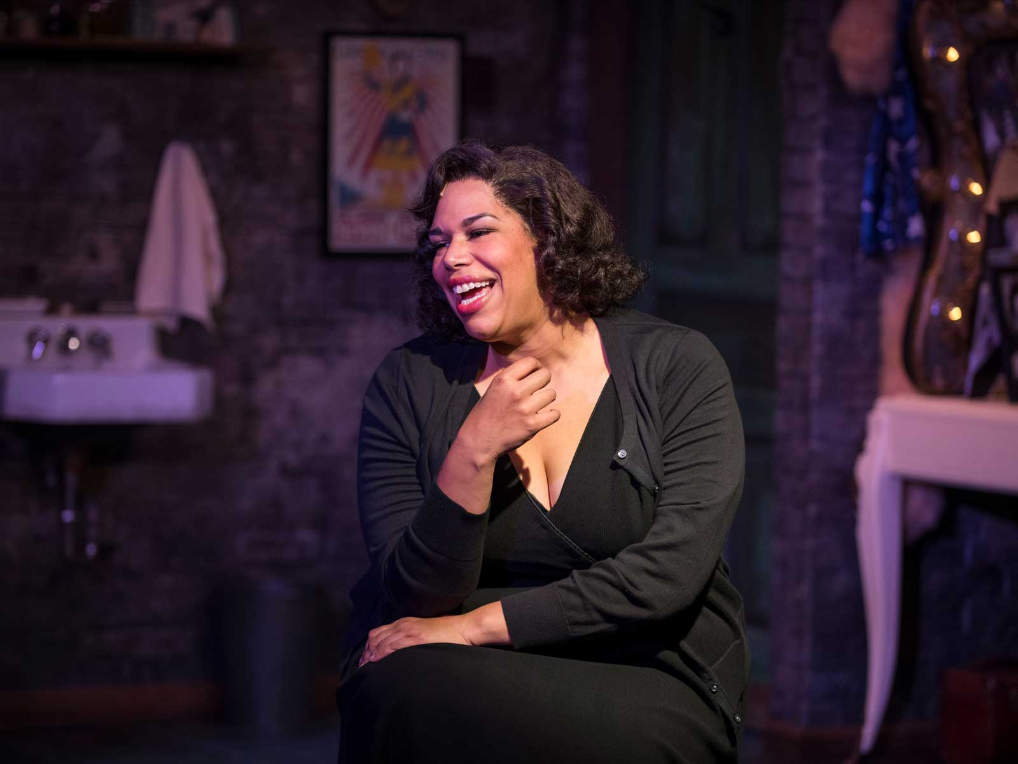
Guards at the Taj
Junk
In the Heights
Ring of Fire: The Music Of Johnny Cash
August Wilson’s Two Trains Running
The Chinese Lady
Songs for Nobodies
14

Slide 16
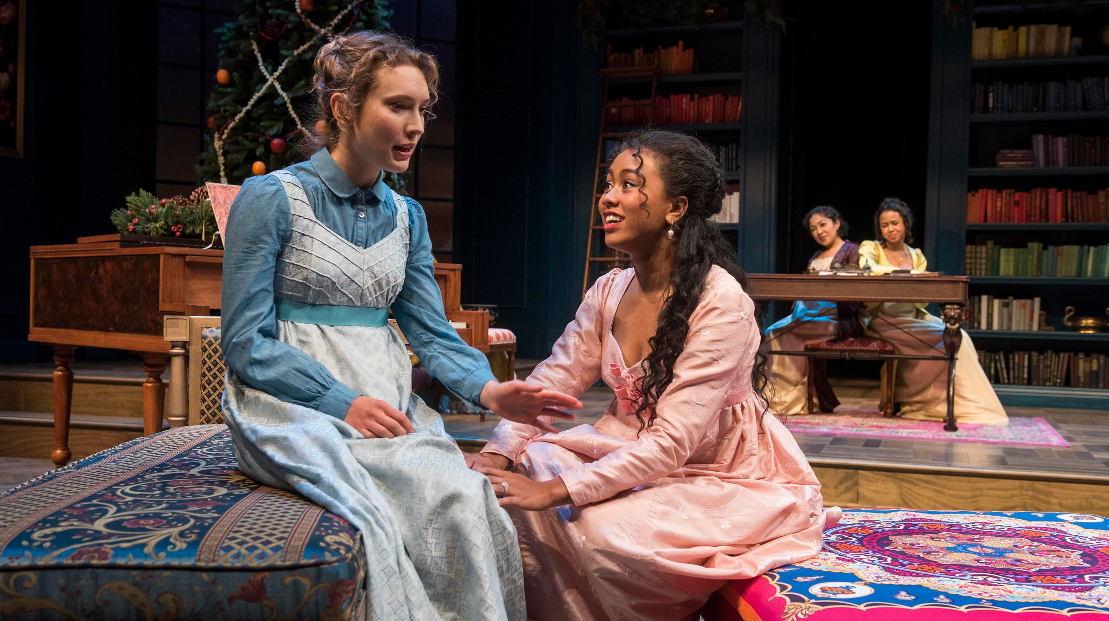
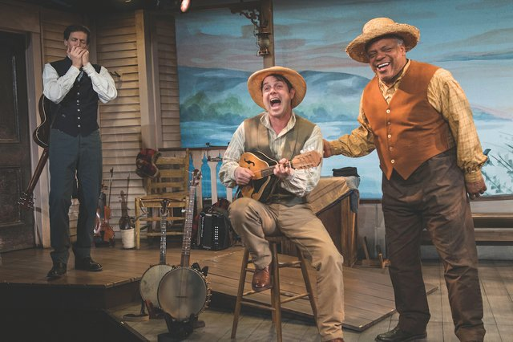
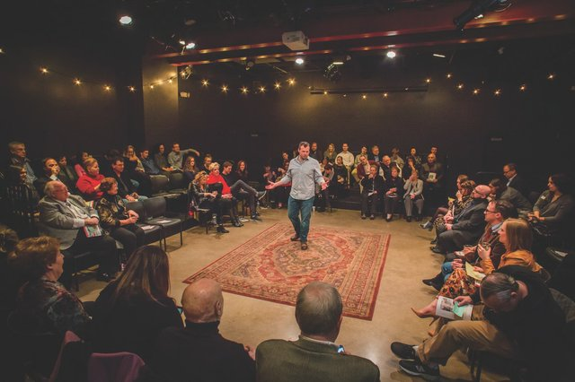
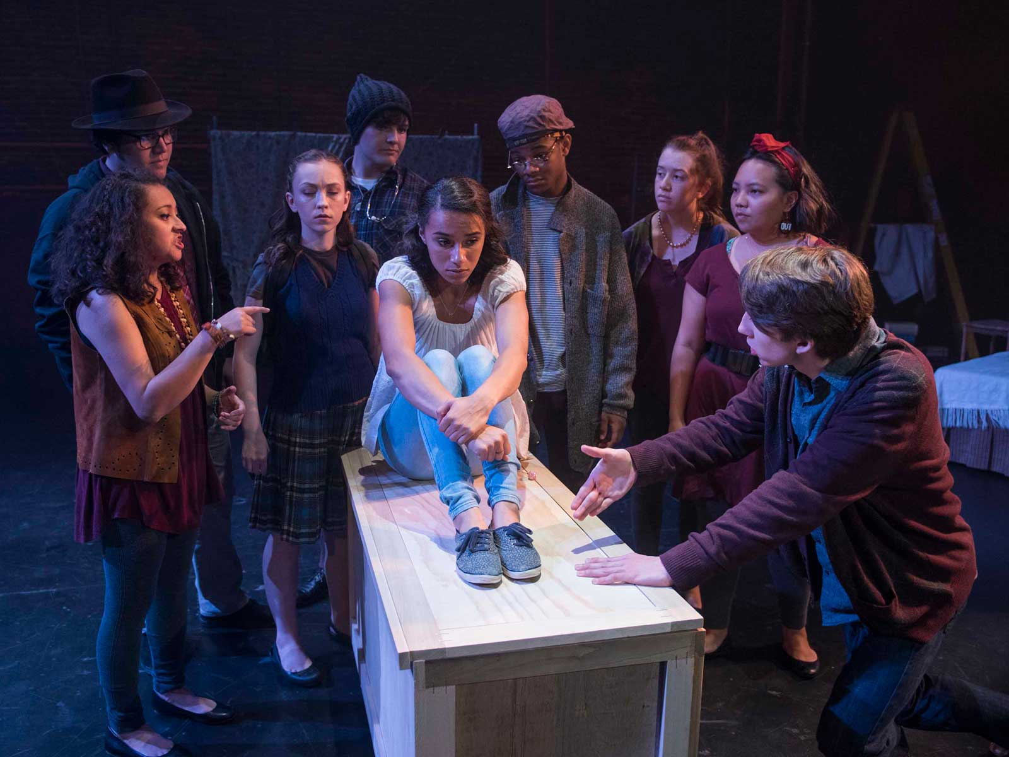
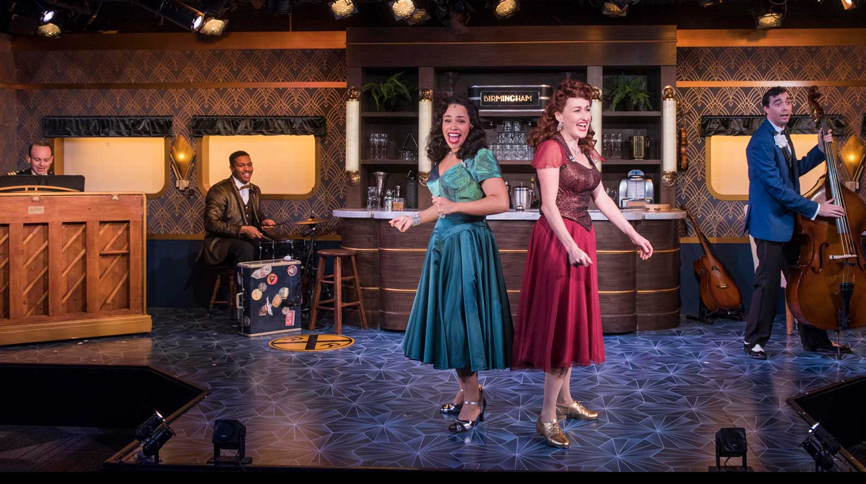
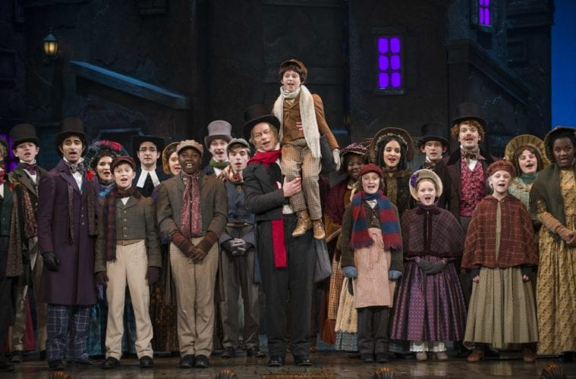
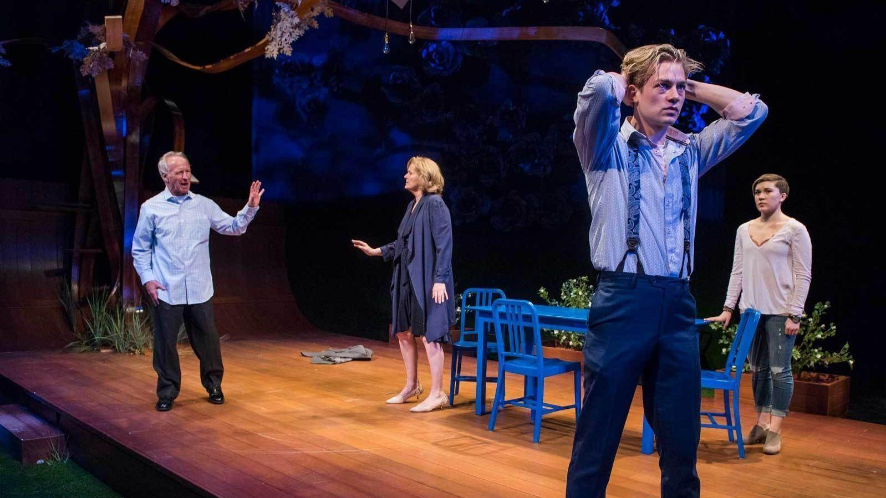
Miss Bennet: Christmas At Pemberley
Mark Twain’s River of Song
Every Brilliant Thing
The All Night Strut
Lost Girl
A Christmas Carol
Things I Know To Be True
14

Slide 17
The Milwaukee Repertory’s 65th Season (2018-2019) Report
“Our 65th anniversary season features one of the largest seasons produced by the Rep in more than a decade featuring 15 productions across 4 theaters with nearly 700 performances” – The Milwaukee Repertory Theater
These productions attempted to draw in diverse audiences with productions that are written and produced by a representative group.
Some stand outs that feature diverse casts and stories:
In The Heights, Guards At The Taj, Junk, The Chinese Lady, August Wilson’s Two Trains Running
(“2018/2019 Season.”)

Slide 18
First Season (1954-1955)
65th Season (2018-2019)
10 straight plays were produced.
1 Variety Show
Combined cast of 10 shows = 95 people
Every cast member was white.
9 out of 11 productions were directed by the resident director Hale McKeen, one by Mary John and the variety show by Catherine Kight (all white).
Playwrights were all white and male except for Late Love by Rosemary Casey, a white female.
Variety of shows produced.
9 plays, 2 of which were world premieres
2 musicals
2 music presentations
1 music tour
1 short play festival
Combined cast of 14 shows
57 white actors compared to 75 people of color actors.
10 directors were white and 4 directors were non-white.
Playwrights were majority white, 11 versus 5.
(Programs.)
(“2018/2019 Season.”)

Slide 19
First Season (1954-1955)
65th Season (2018-2019)
These shows are primarily about white, wealthy to middle class families in various situations from comedy to drama.
The target audience for these productions were white residents of Milwaukee.
The acting company was professionals from Milwaukee, Chicago and New York. The company utilized the star system, where a guest star from New York or Hollywood would headline in each production to attract audiences.
These shows have more diverse content such as Hispanic/Latino immigrants, Taj Mahal imperial guards, Chinese immigrants among others.
The target audiences are for more diverse populations of Milwaukee and the surrounding suburbs.
The Rep no longer uses a star system; instead, actors come from all over the country to perform.
(Mission Statement/Business Plan, 1)
(Programs.)
(“2018/2019 Season.”)
(“2018/2019 Emerging Professional Residents”)

Slide 20
The Importance of Community Representation in Milwaukee’s Theaters
I think that productions that highlight the experience of people of color and present topics relevant to various ethnic communities will encourage diverse audiences to attend. Since Milwaukee’s community is increasingly made up of people of color, diverse theater shows are important to give various communities representation on stage.
One way to increase diversity is through awareness of what shows theater companies produce. Representation in all forms of media is valuable since it allows for voices of people from different backgrounds to be heard (Begel). By having shows in Milwaukee with diverse casts telling their stories, more residents can have representation and present their voice in theater.

Slide 21
Accessible Theater Opportunities
Black Arts MKE
Bronzeville Arts Ensemble
Milwaukee Public Theatre

Slide 22
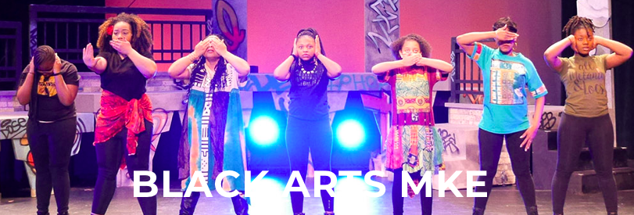
Black Arts MKE
A non-profit organization “committed to preserving the culture by increasing the availability & quality of African American arts” (“Black Arts MKE, Inc. - About.”).
Black Arts MKE partners with local artists and other arts organizations “to bring renowned and original performance arts works by African American authors, playwrights, poets, musicians, and composers” to Milwaukee (“Black Nativity by Langston Hughes 2018 Returns to the Marcus Center’s Wilson Theater at Vogel Hall.”).
Their “arts education outreach and community programs serve over 8,850 low income youth and their families” (“Black Arts Series.”).
Black Arts MKE is a affiliate member of United Performing Arts Fund (UPAF) and an in-residence group at the Marcus Center For The Performing Arts (“Black Nativity by Langston Hughes 2018 Returns to the Marcus Center’s Wilson Theater at Vogel Hall.”).
Photo by Marcus Center for the Performing Arts

Slide 23
Bronzeville Arts Ensemble
“Illuminates the black experience in America by developing and creating theater while providing artistic and educational opportunities.”
Bronzeville Arts Ensemble offers classes for actors, dancers and playwrights to continue theater education opportunity for Milwaukee residents.
They collaborate with community organizations and other artists to provide a creative outlet for local and regional artists.
Their goals:
“Develop new plays and musicals, told through the lense of people of the African diaspora
collaborate with other theaters and community-based organizations, using art to heal, discover, explore and encourage dialogue inspired by the world around us
mentor and cultivate new and emerging talent in Milwaukee
challenge and inspire Bronzeville Arts Ensemble (BAE) members and other local artists; provide an artistic home to create and share the art of theater
engage the local community through workshops, conferences, festivals, discussions and other events, providing a social outlet”
“Bronzeville Arts Ensemble - About.”

Slide 24
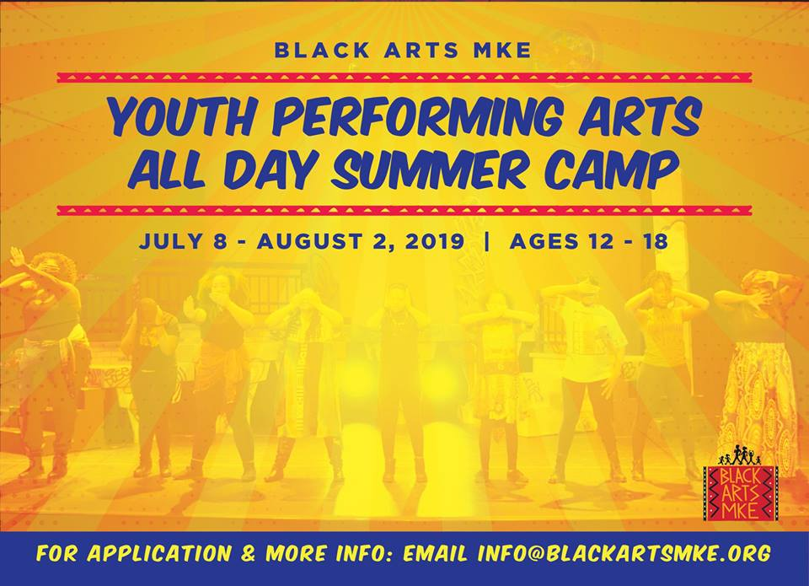
Black Arts MKE & Bronzeville Arts Ensemble
These two organizations often partner together for theater productions and classes.
Performing Arts All-day Summer Camp For City Kidz
A “musical theater experience for disadvantaged city of Milwaukee youth ages 12 to 18.”
Taught by Bronzeville Arts Ensemble & Black Arts MKE teaching artists. (“Black Arts MKE, Inc. - About.”).
Annually produces Black Nativity By Langston Hughes. Both involved in the Marcus Center For The Performing Arts’ BLACK ARTS SERIES (“Black Arts Series.”).
Photo by Black Arts MKE
23

Slide 25
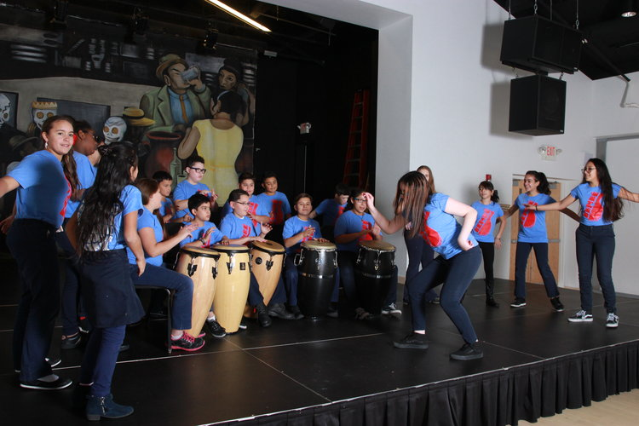
Milwaukee Public Theatre
A professional outreach theater, the company produces outreach events throughout the Milwaukee community for the past 40 years.
“rooted in a profound belief in the arts as an empowering and healing resource that must be available to all people, regardless of age, ability/disability, culture, ethnicity or income level.”
Free-to-the-public performances, parades and pageants in Milwaukee.
This allows for diverse audiences since it removes the obstacle of ticket prices
Photo by Milwaukee Public Theatre
“Milwaukee Public Theatre.”

Slide 26
Milwaukee Public Theatre
Three main groups:
Heard Space is a WPC focused, women-led theater collective that creates origina works.
Bembé is a community-based, intergenerational drum & dance performance program to entertain and also educate the public about racial and cultural identities through afro-latinx music.
Grand Avenue Players Project, in partnership with the grand avenue club, is a program designed to address stigmas associated with mental illness through theater works.
They want to produce original works and help playwrights work on their productions, especially marginalized creators..
Photos by
Milwaukee Public Theatre
“Milwaukee Public Theatre.”

Slide 27
Why Accessible Theater Matters
In a diverse city like Milwaukee, I think it is important that theater productions reflect and represent various communities so different interests can be served. If a show itself features diverse characters, it usually also shows diversity in the cast and crew.
While the Milwaukee Theater scene has made strides in highlighting diverse communities, I think it would be foolish to say that Milwaukee’s theater scene is completely diverse. Many shows are still predominantly aimed towards white audiences with casts of white actors and actresses.

Slide 28
REFERENCES
“2017/18 Emerging Professional Residents.” The Milwaukee Repertory Theater, www.milwaukeerep.com/Inside-The-Rep/Our-Board--Staff/Emerging-Professional-Residents/.
“2018/2019 Season.” The Milwaukee Repertory Theater, Www.Milwaukeerep.Com/Tickets--events/201819-season/.
“A Miller Memorial.” Sentinel, 19 Dec. 1954.
“Black Arts MKE, Inc. - About.” Facebook, Www.Facebook.Com/Blackartsmke/.
“Black Arts Series.” Marcus Center For The Performing Arts - Milwaukee, WI, Www.Marcuscenter.Org/Series/Black-arts-mke
“Black Nativity By Langston Hughes 2018 Returns To The Marcus Center’s Wilson Theater At Vogel Hall.” Urban Milwaukee, 15 Nov. 2018, Urbanmilwaukee.Com/Pressrelease/Black-nativity-by-langston-hughes-2018-returns-to-the-marcus-centers-wilson-theater-at-vogel-hall/.

Slide 29
REFERENCES
Begel, Dave. “Theater Companies Wrestle With Diversity Issues.” Onmilwaukee, 12 Jan. 2016, Onmilwaukee.Com/Raisemke/Articles/Colorblindcasting.Html.
“Bronzeville Arts Ensemble - About.” Facebook, Www.Facebook.Com/Bronzevilleartsensemble/.
Brower, Mitchell. “The Mid-Season Report” from Late Love. Page 3. Programs, Box 7, Folder 1, Milwaukee Repertory Theatre Papers, 1953-1987, Milwaukee Mss 95, University Of Wisconsin-Milwaukee Libraries, Archives Department.
Conlin, Joanne. “Drama, Inc. Brings Civic Theatre To Milwaukee.” Undated. Publicity: Press Releases, Box 7, Folder 2, Milwaukee Repertory Theatre Papers, 1953-1987, Milwaukee Mss 95, University Of Wisconsin-Milwaukee Libraries, Archives Department.
Draft of Letter to Mayor. Undated. Publicity: Press Releases, Box 7, Folder 2, Milwaukee Repertory Theatre Papers, 1953-1987, Milwaukee Mss 95, University Of Wisconsin-Milwaukee Libraries, Archives Department.
“Idiom: A Straight Play.” Targetstudy, Targetstudy.Com/Knowledge/Idiom/A-straight-play.Html.

Slide 30
REFERENCES
John, Mary. “Thank you…” from Oh, Men! Oh, Women! Page 3. Programs, Box 7, Folder 1, Milwaukee Repertory Theatre Papers, 1953-1987, Milwaukee Mss 95, University Of Wisconsin-Milwaukee Libraries, Archives Department.
“Milwaukee Public Theatre.” Milwaukee Public Theatre, Www.Milwaukeepublictheatre.Org/.
“Milwaukee Repertory Theatre Records, 1953-1987.” Archival Resources In Wisconsin: Descriptive Finding Aids: Home, Wisconsin Historical Society, Division Of Library, Archives, And Museum Collections., Digicoll.Library.Wisc.Edu/Cgi/F/Findaid/Findaid-idx?C=wiarchives%3bcc.
Mission Statement/Business Plan from Drama Inc. Undated. Play Possibilities, Box 6, Folder 1, Milwaukee Repertory Theatre Papers, 1953-1987, Milwaukee Mss 95, University Of Wisconsin-Milwaukee Libraries, Archives Department.
“Our History.” The Milwaukee Repertory Theater, Www.Milwaukeerep.Com/Inside-the-rep/Milwaukee-rep-history/.

Slide 31
REFERENCES
Press Release from Fred Miller Theatre re “A town well known for…” . Undated. Publicity: Press Releases, Box 7, Folder 2, Milwaukee Repertory Theatre Papers, 1953-1987, Milwaukee Mss 95, University Of Wisconsin-Milwaukee Libraries, Archives Department.
Press Release from Fred Miller Theatre re “Milwaukee’s new professional theatre…” Undated. Publicity: Press Releases, Box 7, Folder 2, Milwaukee Repertory Theatre Papers, 1953-1987, Milwaukee Mss 95, University Of Wisconsin-Milwaukee Libraries, Archives Department.
Photos, Box 6, Folders 7-14, Milwaukee Repertory Theatre Papers, 1953-1987, Milwaukee Mss 95, University Of Wisconsin-Milwaukee Libraries, Archives Department.
“Production History 1954-1980.” The Milwaukee Repertory Theater, Www.Milwaukeerep.Com/Inside-the-rep/Production-history/.
Programs, Box 7, Folder 1, Milwaukee Repertory Theatre Papers, 1953-1987, Milwaukee Mss 95, University Of Wisconsin-Milwaukee Libraries, Archives Department.

