Slide 1

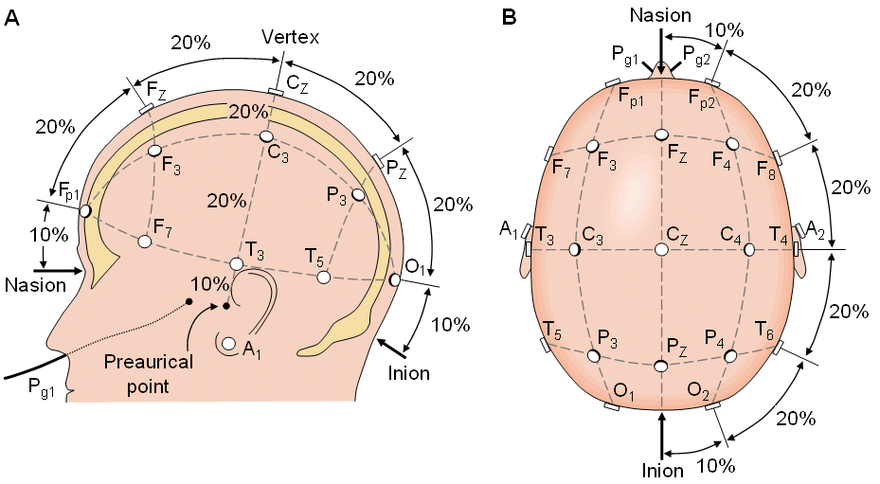
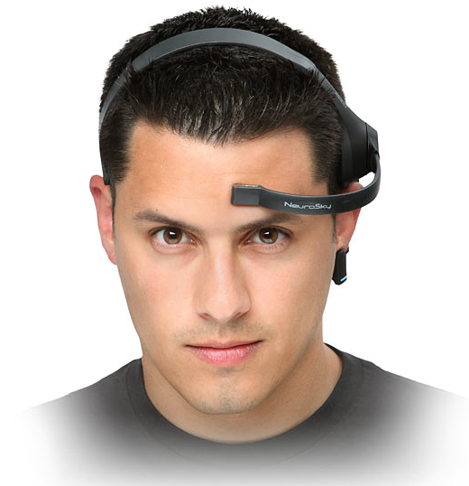

The Association Between Cognitive Interference, Anxiety, and Frontal Beta Brainwave Patterns
Lukas Dommer, Salahadin Lotfi, Christine Larson, & Hanjoo Lee
Department of Psychology | University of Wisconsin-Milwaukee, dommerk2@uwm.edu, slotfi@uwm.edu
Background
Methods
Discussion
Feelings of anxiety are correlated with greater electrical brain activity that is reflected by different frequency bands (e.g. Delta, Theta, Alpha, Beta, and Gamma). Greater brain activity is known to be associated with cognitive tasks. It has been shown that higher brain activity is associated with more difficult cognitive tasks.
Anxiety causes performance deficits, due to individuals repetitively focusing on negative emotions or situational aspects, thus negatively affecting cognition.
Cognitive interference/bias causes individuals to incorrectly evaluate or reason, due to their focus on the high interference of contrary or irrelevant stimuli.
Further, it has been suggested that cognitive bias is associated with frontal Beta band activity: stronger frontal Beta activity is indicative of distraction filtering deficiency.¹ Specifically, Beta activity of the mid-frontal lobe, driven from the cortico-hippocampal-limbic system, which is operative of memory and cognitive processes. ²
EEG recordings from 14 channels using BioPac MP-150 were conducted on a sample of undergraduate students (N=26), who scored 44 or above on the STAI-Trait Anxiety Inventory. ⁶
To analyze the data, AcqKnowledge and SPSS software were both used.
Only data from the frontal EEG electrode was used for the analysis of the data.
Data used in this analysis was taken at baseline from a larger study conducted in the Anxiety Disorders & Affective Neuroscience Laboratories at UWM.
It is suggested that anxiety reduces efficient functioning of the goal-directed attentional system and increases the extent that processing is affected by the stimulus-driven attentional system. In addition to decreasing attentional control, anxiety has shown to increase attention to threat-related stimuli. ⁶
Individuals who reported high scores of anxiety based on RAQ, also demonstrated slower reaction time to Flanker task trials with distractions compared with Flanker task trials with no distractions, indicating distraction filtering deficiency.
Confirming the hypotheses, the EEG recordings indicated these individuals had a significant amount of frontal Beta peak frequency brain activity, corresponding with high levels of anxiety.
Their Beta wave activities were also negatively associated with a poor performance on the Flanker task, thus correlating frontal Beta frequency band with high cognitive bias.
A multiple linear regression analysis was calculated to investigate whether the association of Beta brain activity and cognitive bias depends on levels of anxiety. Results showed that the interaction between cognitive bias and levels of anxiety were significant, suggesting that the effect of cognitive bias on Beta brain activity depended on the different levels of anxiety.
These hypotheses examine a topic with a large interest. These results are of interest to scientists of many backgrounds, due to the information regarding brain processes that deal with distractions, which can be used in the context of everyday life.
Potential implications of this study practically regard any contexts or operations that require extreme attentional and cognitive execution. Utilizing modern, wireless EEG could potentially notify high Beta activity, thus indicating higher rates of committing errors for said tasks under stressful situations.
Future studies could possibly assess the Beta brainwave frequencies as they relate to other various, more complex inhibitory control tasks.
Race and ethnicity
85% Caucasian
Gender
82 % Female
Age
Mean age = 23.07
11% African American
4% others
18% Male
SD = 6.2
Results
 | Frontal Beta Brainwave | Anxiety | Cognitive Bias
M | 11.17 | 76.35 | 50.56
N | 26 | 26 | 26
SD | 1.72 | 21.12 | 22.69
Hypotheses/Research Aims
Whether EEG recording will confirm high levels of anxiety reflected, measured, and located by a specific EEG frequency band.
  Are Beta brainwave frequencies associated with anxiety?
Whether EEG recording will confirm high levels of cognitive bias reflected, measured, and located by a specific EEG frequency band.
  Are Beta brainwave frequencies associated with cognitive bias?
Whether there will be a significant prediction of inordinate amounts of brain activity within a common frequency band by levels of anxiety and cognitive bias.
  Do levels of anxiety and cognitive bias interact with one another in a certain frequency band?
 | Anxiety | Cognitive Bias
Frontal Beta Pearson Correlation | .383* | .448*
Sig. (2-tailed) | .048 | .022
N | 26 | 26
*. Correlation is significant at the 0.05 level (2-tailed).
Multiple linear regression analysis of Frontal Beta Peak Frequency vs. RAQ and Flanker task. Pearson correlations of RAQ and Flanker task with Frontal Beta Peak Frequency.
Regression Line
Measures
Acknowledgments
1. Response to Anxiety Questionnaire (RAQ). A 32-item self-report questionnaire assessing anxiety through a scale of 1-4. ³
2. Eriksen Flanker Task. A set of response inhibition tests assessing the ability to suppress responses that are inappropriate in a particular context. ⁴
3. State-Trait Anxiety Inventory (STAI-T). A 20-item self-report questionnaire assessing state or trait anxiety. ⁵
4. Electroencephalogram (EEG). A test used to evaluate, track, and record the electrical activity in the brain.
FRONTAL BETA
This study is supported by grants from the Sigma Xi Grants-in-Aid of research awarded to Salahadin Lotfi, the Support for Undergraduate Research Fellows grant awarded to Lukas Dommer, and UWM RGI to Drs. Christine Larson and Hanjoo Lee.
Predicted Value
References
1. Klimesch, W., Doppelmayr, M., Schimke, H., Ripper, B., 1997. Theta synchronization and alpha desynchronization in a memory task. Psychophysiology 34, 169–176.
2. Cavanagh, J.F., & Shackman, A.J. (2015). Frontal midline theta reflects anxiety and cognitive control: meta-analytic evidence. Journal of Physiology- Paris, 109, 3-15.
3. Taylor, D. L., Grant, D. M., Frosio, K. E., Kraft, J. D., & White, E. J. (2018). Psychometric Properties of the Response to Anxiety Questionnaire. Journal of Psychopathology and Behavioral Assessment, 1-13.
4. Eriksen, B. A., & Eriksen, C. W. (1974). Effects of noise letters upon the identification of a target letter in a nonsearch task. Perception & Psychophysics, 16(1), 143-149. doi:10.3758/bf03203267
5. Spielberger, C. D., Gorsuch, R. L., & Lushene, R. E. (1970). STAI manual for the state-trait anxiety inventory: (Self-evaluation questionnaire). Palo Alto, CA: Consulting Psychologists Press.
6. Eysenck, M. W., Derakshan, N., Santos, R., & Calvo, M. G. (2007). Anxiety and cognitive performance: attentional control theory. Emotion, 7(2), 336.
R=.383*
R=.448*

